Slide 1


SAVEETHA SCHOOL OF ENGINEERING SAVEETHA INSTITUTE OF MEDICAL AND TECHNICAL SCIENCES
Privacy-Preserving Data Analytics Platform
GU I DED BY DR.K.Selvakumar swamy PROFESSOR DEPARTMENT OF CSE
SAVEETHA SCHOOL OF ENGINEERING SIMATS,CHENNAI-602105.
SUBMITTED BY
P.NAVEEN (192210649)
DEPARTEMENT OF CSE
SAVEETHA SCHOOL OF ENGINEERING SIMATS,CHENNAI-602105.

Slide 2
purpose
Ensuring that personal or sensitive data remains confidential and is not exposed during the data analysis process. This is crucial for maintaining user trust and complying with legal and ethical standards.
Allowing organizations to share and analyze data collaboratively without revealing sensitive information. This facilitates joint research and data-driven decision-making across different entities while preserving privacy.
Building trust among users, customers, and stakeholders by demonstrating a commitment to protecting their privacy. Trust is critical for the success of data-driven initiatives and for encouraging individuals to share their data

Slide 3
Abstract
A privacy-preserving data analytics platform incorporates several key
abstractions to ensure the confidentiality and integrity of sensitive information
while enabling meaningful analysis and insights. At its core, the platform
employs advanced cryptographic techniques and privacy-enhancing
technologies to safeguard data throughout its lifecycle. Encryption
secures data both at rest and in transit, ensuring that unauthorized parties cannot
access sensitive information without proper decryption keys. Anonymization
techniques further protect privacy by removing or obfuscating personally
identifiable information (PII) from datasets, thereby preventing re-identification
of individuals while still allowing for meaningful analysis. This preserves data confidentiality
during processing and analysis, crucial for scenarios where data sovereignty and
privacy compliance are paramount. They track and log access to data, actions taken on the data, and ensure compliance with data protection regulations such as GDPR or CCPA.

Slide 4
Introduction
The goal of this privacy preserving data analytics Platforms course is to introduce students to the world .how to preserving the privacy data from malware.
We live in the age of big data. With an increasing number of people, devices, and sensors connected with digital networks, individual data now can be largely collected and analyzed to understand important phenomena
In the retail market, individual purchase histories are used by recommendation tools to learn trends and patterns. Performing analytics on private data is clearly beneficial, such as early detection of disease and recommendation services
However, user concerns rise from a privacy perspective, with sharing an increasing amount of information regarding their health, location, service usage, and online activities.

Slide 5
Educational goal
Educating users on the principles of data privacy, including why it's important and how it can be compromised..
Raising awareness about the ethical implications of data collection, analysis, and sharing, emphasizing the need to balance data utility with privacy protection.
Teaching the technical methods and algorithms used in PPDA, such as differential privacy, homomorphic encryption, secure multi-party computation, and federated learning.
Encouraging research and innovation in the field of privacy-preserving data analytics, fostering the development of new methods and technologies to enhance data privacy.

Slide 6
SoftwareAssingment
The software assignment covers a total of five sessions at the start of the course.
The goal of this step is to highlight the difficulty of efficiently implementing very large word length operations (1024-bit squaring in RSA) in resource-constrained SW platforms such as the 8-bit 8051.
Starting from sample code, students are expected to implement all operations required by the cryptographic algorithm in the lower multiprecision and modular arithmetic layers.
In the last session, dealing with software optimization, Gain hands-on experience with tools and libraries designed for privacy-preserving data analytics.

Slide 7
Literature survey
Mohassel,, P., Zhang, Y. (2017): "SecureML: A System for Scalable Privacy-Preserving Machine Learning" discusses practical implementations of privacy-preserving machine learning using cryptographic techniques..
PySyft: An open-source library for encrypted, privacy-preserving machine learning, which integrates with PyTorch to allow for secure, decentralized training.
An extension of TensorFlow that provides implementations of differential privacy algorithms, enabling the training of privacy-preserving machine learning models

Slide 8
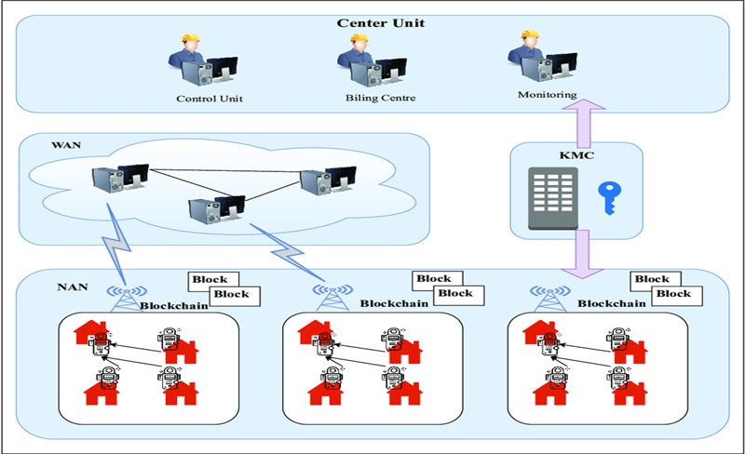
Architecture

Slide 9
Result
By integrating strong encryption techniques, the platform ensures that data remains secure both at rest and in transit.
This robust encryption framework provides a high level of data security, making it extremely difficult for malicious actors to compromise the data.
These methods significantly reduce the risk of re-identification and protect personal information.
Regular data backups and a comprehensive disaster recovery plan enhance the platform’s resilience

Slide 10
Conclusion
We formally proved that both mechanisms satisfy differential privacy. Empirical studies with real-world data sets confirm that our solutions enable accurate data analytics on a small fraction of the input data, reducing user privacy cost and data storage requirement without compromising utility
For real-time applications, we would like to consider how to dynamically sample user generated data, in order to further reduce the data storage requirement.
Our solutions benefit from sampling techniques that reduce the individual data contribution to a small constant factor, and thus reducing the perturbation error inflicted by differential privacy

Slide 11
References
[1] M. Barbaro and T. Zeller. A face is exposed for aol searcher no. 4417749.
The New York Times, Aug. 2006.
[2] J. Bennett and S. Lanning. The netflix prize. In Proceedings of KDD cup
and workshop, volume 2007, page 35, 2007.
[3] B. Berjani and T. Strufe. A recommendation system for spots in locationbased online social networks. In Proceedings of the 4th Workshop on 15 Social Network Systems, SNS ’11, pages 4:1–4:6, New York, NY, USA, 2011. ACM.
[4] A. Blum, K. Ligett, and A. Roth. A learning theory approach to noninteractive database privacy. In Proceedings of the 40th annual ACM symposium on Theory of computing, pages 609–618, New York, 2008. ACM.
[5] T.-H. H. Chan, E. Shi, and D. Song. Private and continual release of statistics. ACM Trans. Inf. Syst. Secur., 14(3):26:1–26:24, Nov. 2011.
[6] K. Chaudhuri and N. Mishra. When random sampling preserves privacy. In Proceedings of the 26th annual international conference on Advances in Cryptology, CRYPTO’06, pages 198–213, Berlin, Heidelberg, 2006. SpringerVerlag.
[7] R. Chen, G. Acs, and C. Castelluccia. Differentially private sequential data publication via variable-length n-grams. In Proceedings of the 2012 ACM conference on Computer and communications security, CCS ’12, pages 638–649,
2012

Slide 12


